Slide 1
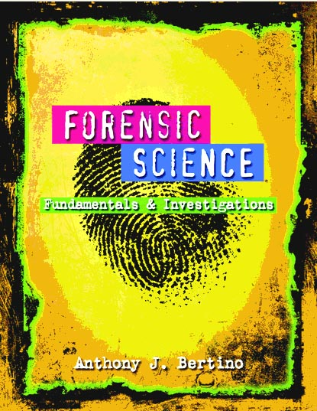
Chapter 6 Fingerprints
By the end of this chapter you will be able to:
Discuss the history of fingerprinting
Describe the characteristics of fingerprints and fingerprinting minutiae
Identify the basic types of fingerprints
Describe how criminals attempt to alter their fingerprints
Determine the reliability of fingerprints as a means of identification
Explain how fingerprint evidence is collected
Determine if a fingerprint matches a fingerprint on record
Use the process of lifting a latent print
All Rights Reserved South-Western / Cengage Learning © 2012, 2009
Forensic Science: Fundamentals & Investigations, Chapter 6

Slide 2
Historical Development
3rd century(300) B.C. in China—oldest known documents
Ancient Babylon (1792-1750 B.C.)—fingerprints pressed into clay tablets marked contracts
1684—Dr. Nehemiah’s paper describes the patterns on human hands, including the presence of ridges
1788—Johann Mayer noted that the arrangement of skin ridges is never duplicated in two persons
Forensic Science: Fundamentals & Investigations, Chapter 6

Slide 3
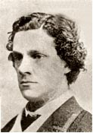
Historical Development
1823—Jan Evangelist Purkyn describes nine fingerprint patterns
1856—Sir William Herschel (right) began the collection of fingerprints and noted they were not altered by age
1883—Alphonse Bertillon created a way to identify criminals that were repeat offenders
Forensic Science: Fundamentals & Investigations, Chapter 6

Slide 4

Historical Development
1888—Sir Francis Galton (r) and Sir Edmund
Richard Henry developed the fingerprint
classification system still used in the US
1896—Sir Henry, with two colleagues, created a system that divided fingerprints into groups. All ten fingerprints are imprinted on a card (called a ten card) along with other notations
Forensic Science: Fundamentals & Investigations, Chapter 6

Slide 5
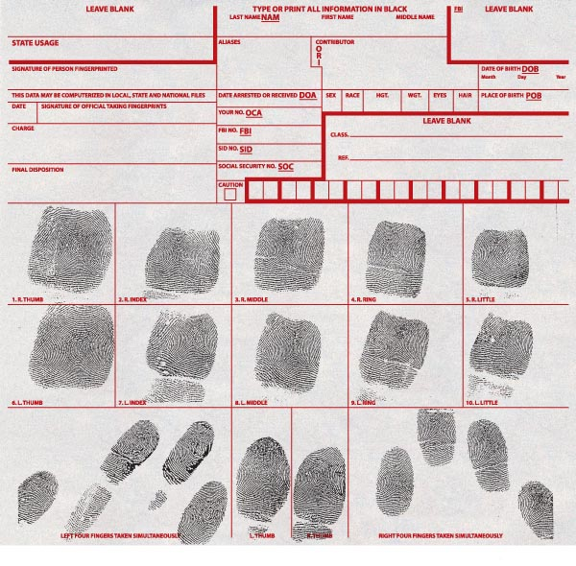
Example of a Ten Card
Forensic Science: Fundamentals & Investigations, Chapter 6

Slide 6
What Are Fingerprints?
Impressions (of ridges) made by fingers, toes, feet, and palms
  Ridges help us grip objects
  Ridges are arranged in connected units called dermal, or friction, ridges
  Fingers accumulate natural secretions and dirt
  Fingers leave create prints on objects we touch
Forensic Science: Fundamentals & Investigations, Chapter 6

Slide 7
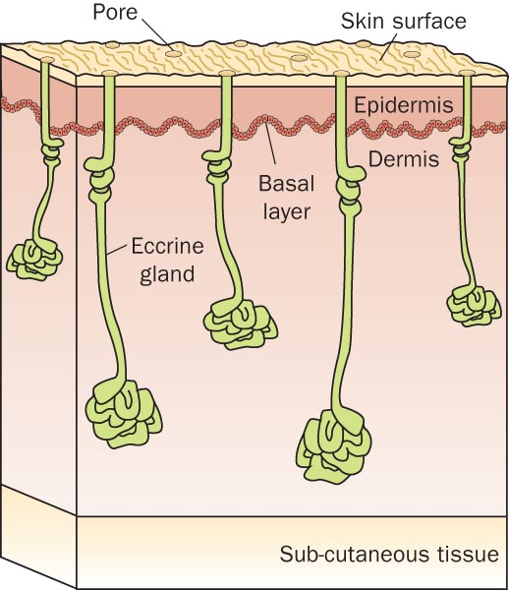
Structure of Skin
  Outer layer -epidermis
Basal layer
Basal layer grows faster than the layers above and below it
Basal layer collapses and folds to form intricate shapes
Fingerprints begin forming near the 10th week of pregnancy
  Inner layer-dermis
Forensic Science: Fundamentals & Investigations, Chapter 6

Slide 8
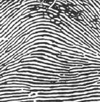
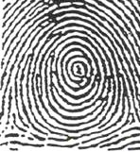
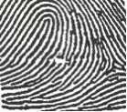
Characteristics of Fingerprints
There are 3 general fingerprint distinctions:
ARCH About 5% | WHORL About 30% | LOOP About 65%
 | of the population
Forensic Science: Fundamentals & Investigations, Chapter 6

Slide 9
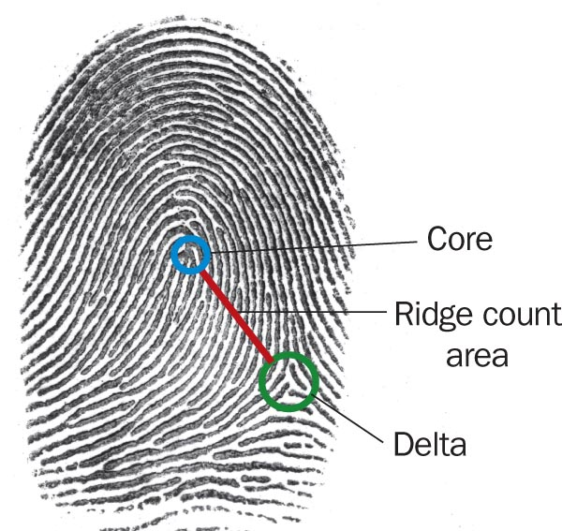
Characteristics of Fingerprints
Forensic examiners look for
  Core
  (the center of a whorl or loop)
  Deltas
  (triangular regions near a loop)
Ridge count
  Counting from the core to the edge of the delta
  Distinguishes one fingerprint from another
Forensic Science: Fundamentals & Investigations, Chapter 6

Slide 10
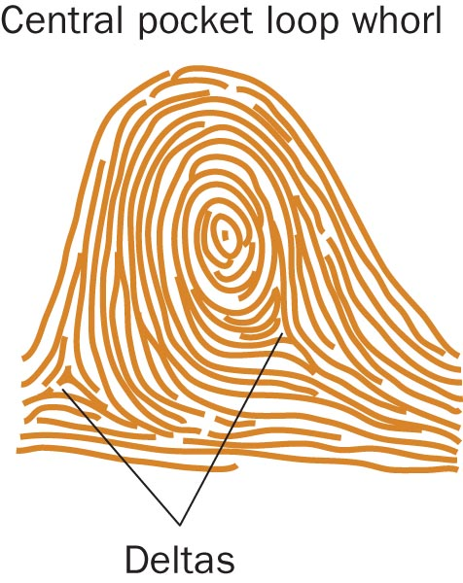
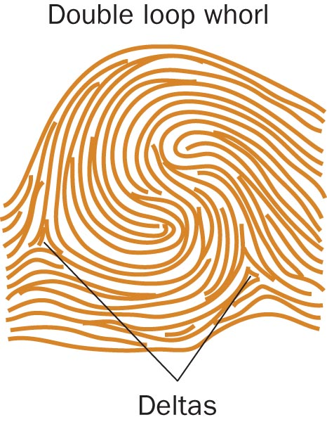
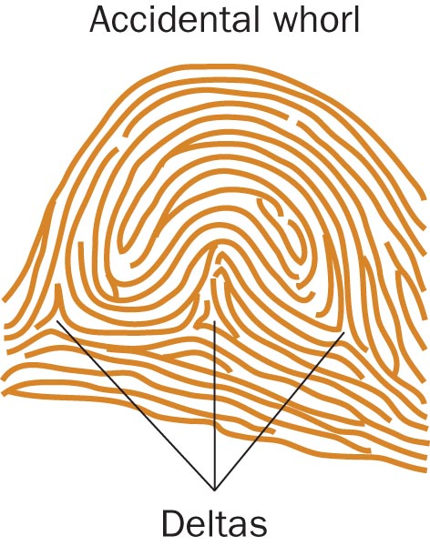
Characteristics of Fingerprints
Forensic Science: Fundamentals & Investigations, Chapter 6

Slide 11
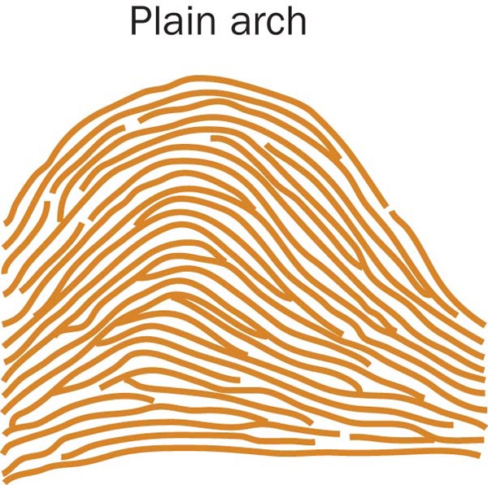
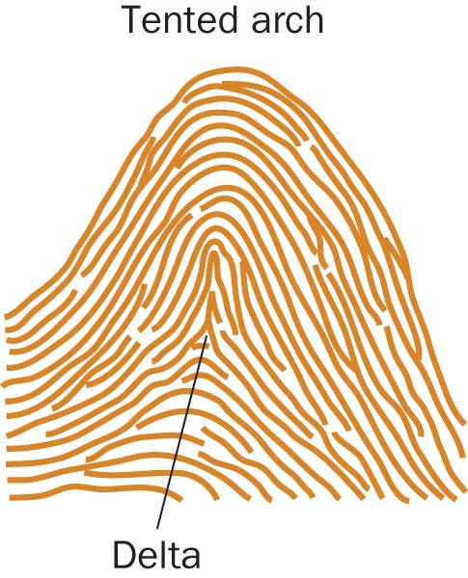
Characteristics of Fingerprints
Forensic Science: Fundamentals & Investigations, Chapter 6

Slide 12
Characteristics of Fingerprints
Basic patterns can be further divided:
  Arch patterns:
    4% plain
    1% tented
  Whorl patterns:
    2% central pocket
    4% double loop
    0.01% accidental
Even twins have unique fingerprints
Forensic Science: Fundamentals & Investigations, Chapter 6

Slide 13
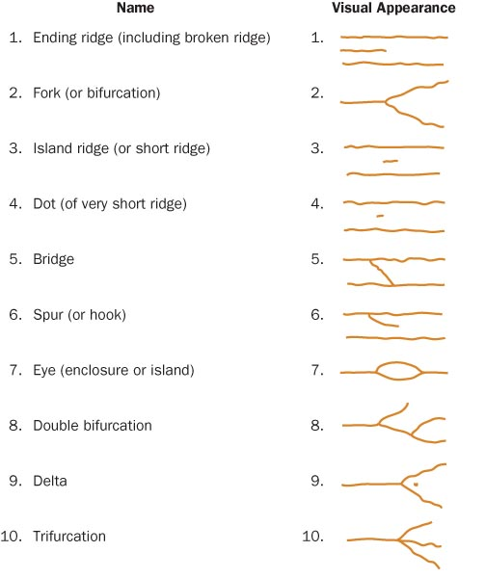
Fingerprint Minutiae Patterns
Forensic Science: Fundamentals & Investigations, Chapter 6

Slide 14
Types of Fingerprints
There are 3 types of prints that investigators look for at crime scenes:
  Patent fingerprints—visible prints transferred onto smooth surfaces by blood or other liquids
  Plastic fingerprints—indentations left in soft materials such as clay or wax
  Latent fingerprints—made visible by dusting with powders or the use of chemicals
Forensic Science: Fundamentals & Investigations, Chapter 6

Slide 15
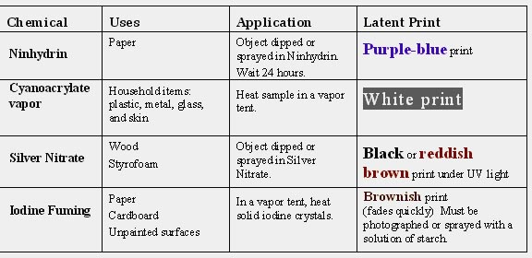
Fingerprint Forensic FAQs
How are latent fingerprints collected?
Forensic Science: Fundamentals & Investigations, Chapter 6

Slide 16
Fingerprint Forensic FAQs
Can fingerprints be erased?
Only temporarily; they will grow back if removed with chemicals
Is fingerprint identification reliable?
Yes, but analysts can make mistakes
Can computers perform matches in seconds?
No, but the FBI’s Integrated Automated Fingerprint Identification System (IAFIS or AFIS) can provide a match in 2 hours
Forensic Science: Fundamentals & Investigations, Chapter 6

Slide 17
The Future of Fingerprinting
New scanning technologies
  Yield detail in minute patterns
  Reduce analytical mistakes
  Analyze trace elements of objects on the skin
Technologies that recognize patterns in
  Retina
  Face
  Veins in your palm
Forensic Science: Fundamentals & Investigations, Chapter 6

Slide 18
. . . . . . . . . . . . . . Summary . . . .
Fingerprints have long been used for identification, and in the mid-1800s were recognized as unique to each person.
Three main groups include arches, whorls,
and loops.
Basic analysis includes looking for cores and deltas and making a ridge count.
Forensic Science: Fundamentals & Investigations, Chapter 6

Slide 19
. . . . . . . . . . . . . . . . . Summary
Investigators search for patent, plastic, and latent prints.
Dusting with powders or using special chemicals can make latent fingerprints visible.
New developments may eliminate errors by analysts.
Forensic Science: Fundamentals & Investigations, Chapter 6

